Slide 1


Data
Analysis

Slide 2


Today's agenda
Project recap
Problem
The Analytics team
Process
Insights
Summary

Slide 3

Social Buzz is a fast growing technology unicorn that need to adapt quicky to it’s global scale.
Accenture has begun a 3 month initial project focusing on these tasks:
An audit of their big data practice
Recommendations for a successful IPO
An analysis of their content categories that highlights the top 5 categories
Project Recap

Slide 4

Problem
There are over 100,000 posts per day
But how to capitalize on it when there is so much data?
To find Social Buzz’s Top 5 most popular categories of content

Slide 5



ANDREW FLEMING
Chief Technical Architect
The Analytics team
MARCUS ROMPTON
Senior Principle
PRAGATI DEVANPALLI
Data Analyst

Slide 6
Process
1
Data Understanding
2
Data Cleaning
3
Data Modelling
4
Data Analysis
5
Uncover Insights

Slide 7

Insights
Top 5 Categories Animal, Science, Health Eating, Technology and Food
16
Unique Categories
1897
Reaction to “Animal” Post

Slide 8
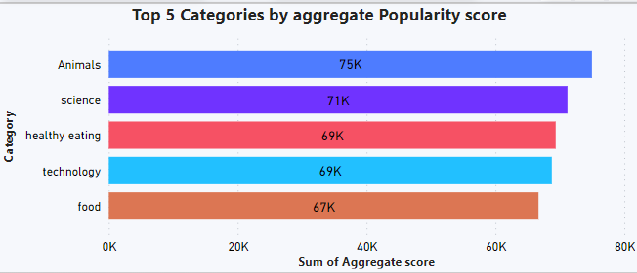

Slide 9
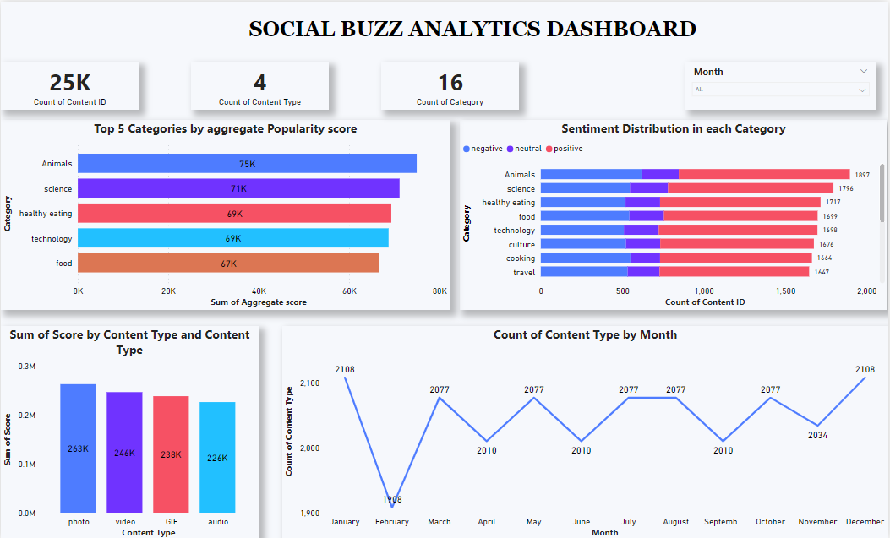

Slide 10

ANALYSIS
Animals and science are the most popular categories and content, showing that in today’s world people enjoy real-life and factual content the most
INSIGHT
Here, food comes in the top 5 categories, with "Healthy Eating" ranking third. You can use this insight to create a campaign and work with healthy eating brands to boost your users.
Summary

Slide 11
Thank you!
ANY QUESTIONS?

